Slide 1
LAN Connections
Using the Cisco SDM

Slide 2
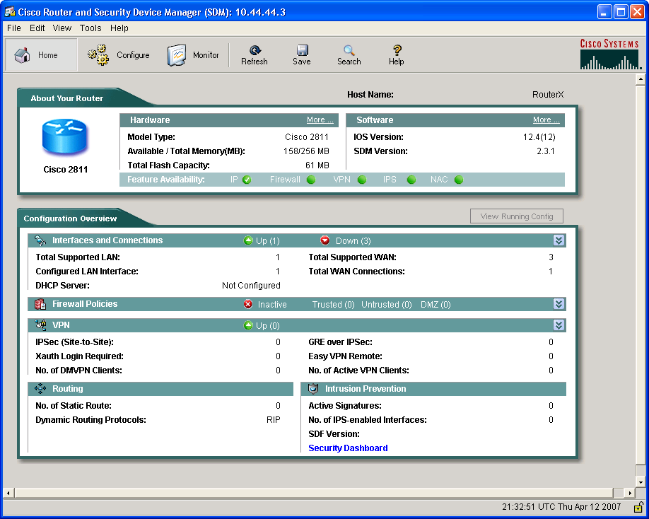
Cisco Router and Security Device
Manager

Slide 4
What Is Cisco SDM?
  Embedded web-based management tool
  Provides intelligent wizards to enable quicker and easier deployments and does not require knowledge of Cisco IOS CLI or security expertise
  Tools for more advanced users:
    ACL editor
    VPN crypto map editor
    Cisco IOS CLI preview
Notes:
What is Security Device Manager (SDM)?
SDM is an easy-to-use Internet browser-based device management tool that is embedded within the Cisco IOS 800 – 3700 Series access routers at no cost.
It simplifies router and security configuration through the use of intelligent wizards to enable customers and partners to quickly and easily deploy, configure and monitor a Cisco access router.
SDM is designed for resellers and network administrators of small- to medium-sized businesses who are proficient in LAN fundamentals and basic network design, but has little or no experience with IOS command-line interface (CLI) or may not be a security expert.
SDM is also great for Advanced users too. It has a number of time saving tools. Examples include ACL editor, VPN crypto map editor, IOS CLI preview, and many more.

Slide 5
Supported Cisco Routers and Cisco IOS Software Releases
  Cisco SDM is supported on a number of Cisco router platforms and Cisco IOS Software releases.
  Always verify Cisco SDM router and Cisco IOS release support at www.cisco.com/go/sdm.

Slide 6
Configuring Your Router to Support SDM
Enable the HTTP and HTTPS servers on your router.
Create a user account defined with privilege level 15 (enable privileges).
Configure SSH and Telnet for local login and privilege level 15.

Slide 7
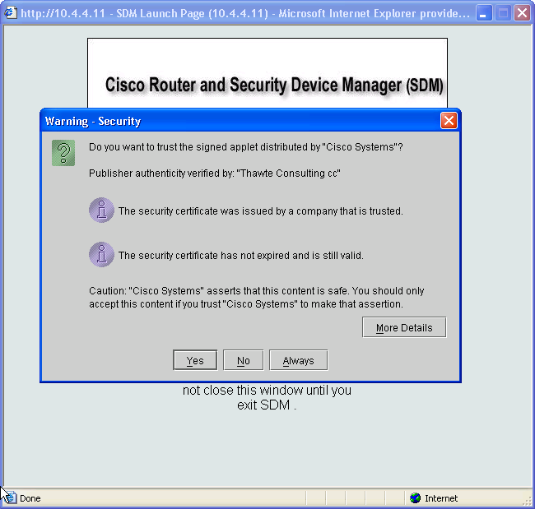
SDM Startup

Slide 9
Cisco SDM Main Window Layout and Navigation
Menu Bar
Toolbar
Router
Information
Configuration
Overview
Notes:
When SDM is launched, SDM reads the existing router configuration. You will see a message stating this.
Then it will present the features that it supports as available for configuration through the SDM.
At the top of the screen you will see the typical menu bar with File, view, edit, tools and help.
Below that is the SDM tool bar. It has the SDM wizards and modes you can select.
On the left side under the tool bar displays the current mode you are in.
The menu, tool bar, and current mode are always displayed at the top of each screen. The other parts of the screen change based upon the mode and function you are performing.
The far left panel is the Category Bar. It changes with the options available based on the mode you are in.
When you log in, the first page displayed is the Overview page. It gives you a great summary of the router.
It displays the router model, total amount of memory and flash, IOS and SDM versions, the hardware installed and a summary of some security features such as firewall status and the number of active VPN connections.

Slide 10
Menu Bar
Toolbar
Router
Information
Configuration
Overview

Slide 11
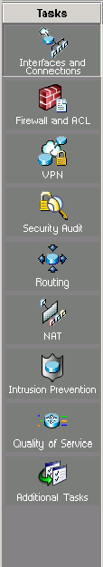
Cisco SDM Wizards
  LAN configuration: Configure LAN interfaces and DHCP
  WAN configuration: Configure PPP, Frame Relay, and HDLC WAN interfaces
  Firewall
  VPN
  Security audit: Perform a router security audit, with a button for router lockdown
  IPS: Intrusion prevention system
  QoS: Quality of service
Notes:
Click Wizard to enter this mode.
If there’s delta configuration within SDM and you attempt to enter the wizard mode a dialog box appears. It states that you must perform a Refresh or Deliver before entering the Wizard Mode. Click either button to perform one of those functions.
When the page appears the wizards are displayed on the left.
I have already describe the Overview page. It is not a wizard, but you can click on some features and it may open a wizard.
LAN wizard is used to configure the LAN interfaces and DHCP.
WAN wizard is used to configure PPP, Frame Relay, HDLC WAN interfaces
Firewall provides two wizards. A simple inside/outside wizard or more complex inside/outside/DMZ with multiple interfaces.
For VPN, there are three wizards. A secure site-to-site VPN, Easy VPN and GRE tunnel with IPSec.
Security Audit contains two wizards. The router security audit and an easy one-step router security lock down wizard.
The last wizard resets the router configuration back to the SDM factory default configuration settings.
While in the Wizard modes, all changes are automatically delivered using generated CLI commands upon finishing the wizard.
A user can choose whether or not to preview the commands sent. The default is “No Preview” which can be altered in the Preferences menu.

Slide 12
  LAN configuration: Configure LAN interfaces and DHCP
  WAN configuration: Configure PPP, Frame Relay, and HDLC WAN interfaces
  Firewall
  VPN
  Security audit: Perform a router security audit, with a button for router lockdown
  IPS: Intrusion prevention system
  QoS: Quality of service

Slide 13
Summary
  Cisco SDM is a useful tool for configuring Cisco access routers.
  Cisco SDM contains several easy-to-use wizards for efficient configuration of Cisco access routers.
  Cisco SDM allows you to customize Cisco access router configurations using advanced features.

